Slide 1

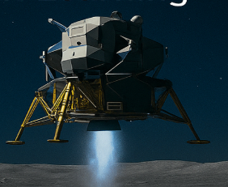
Benchmarking Deep-Q Networks (DQN’s)
against PPO in OpenAI gym
using Lunar Lander-v3
CSCE 5218 - Deep Learning Project – Group 4
Sai Naga Chaitanya A : 11818019
Laxmi Shravani M : 11808481
Shree Harshini M : 11863094
Aryan Patial : 11789784

Slide 2
Problem Statement
Objective:
Which contemporary deep-reinforcement-learning algorithms produce most reliable, Fuel-efficient and sample-efficient landing policy or the Gymnasium Lunar Lander-v3 environment within a fixed training budget.
Safely land lunar module with minimal fuel & high precision
Identify which RL algorithm learns fastest & most efficiently
We aim to answer:
Learning efficiency: Which algorithm reaches the "solved" threshold (+200 average return) in the fewest environment steps?
Final performance: Which algorithm achieves the highest mean reward and success rate after identical training time?
Resource usage: How do algorithms trade off reward against fuel consumption and computational cost?
Stability: Which approach exhibits the lowest variance during and after training?

Slide 3
Environment / Dataset
Simulator: Gymnasium, LunarLander-v3.
State space: 8-dimensional continuous vector : position, velocity, angle, leg contact
Actions space: 4 discrete thruster commands {idle, fire left, fire main, fire right}.
Episode length: ≤ 1 000 steps.
Reward:
+100 … +140 for arriving at the pad,
−100 for crash,
−0.3 per engine firing,
+10 per leg contact, ±100 for clear success/failure.
Compute budget: 500 episodes (≤ 1000 simulation steps each) and 3 random seeds per algorithm.
Evaluation : 30 evaluation episodes (3 seeds × 10)

Slide 4
Proposed Models
Family
Variant
Key idea
Extra Hyper-params (ours)
DQN
Vanilla
Q-learning with target network and replay memory
lr = 1 e-3, γ = 0.99, ε-greedy 1→0.01, batch = 64
Double
Uses two networks to reduce max-Q bias
target update every 1 000 steps
Duelling
Splits final layer into value V(s) and advantage A(s,a) streams
same lr/γ/ε, shared 128-unit hidden layers
PER
Samples experiences proportional to TD-error
α = 0.6, β anneals 0.4→1.0
Policy Gradient
PPO
Clips policy updates to stabilize on-policy learning
lr = 3 e-4, clip = 0.2, n_steps = 1000
All networks use two fully-connected layers of 128 units with ReLU activations; DQN replay buffers hold 50, 000 transitions.

Slide 5
Experimental Design
Budget: 500 episodes × 1 000 steps ≈ 0.5 M environment steps per agent.
Optimizer: Adam (default β₁ = 0.9, β₂ = 0.999).
Target-network sync: every 1000 steps (DQN family).
Compute tracking: wall-clock time via time.perf_counter()
Phase
When
Episodes
Seeds
Metrics
Milestones
100, 200, 300, 400, 500
10 each
3
return, success %, touchdown distance, remaining fuel,stability
Standard Eval
post-training
10
3
Same metrics
Videos (500-step cap) are saved for qualitative inspection at every checkpoint.

Slide 6
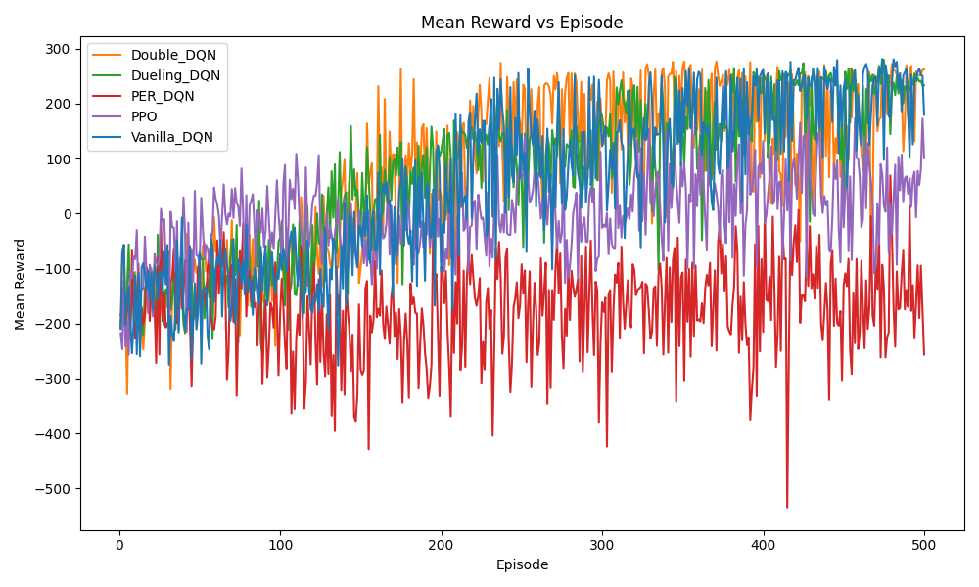
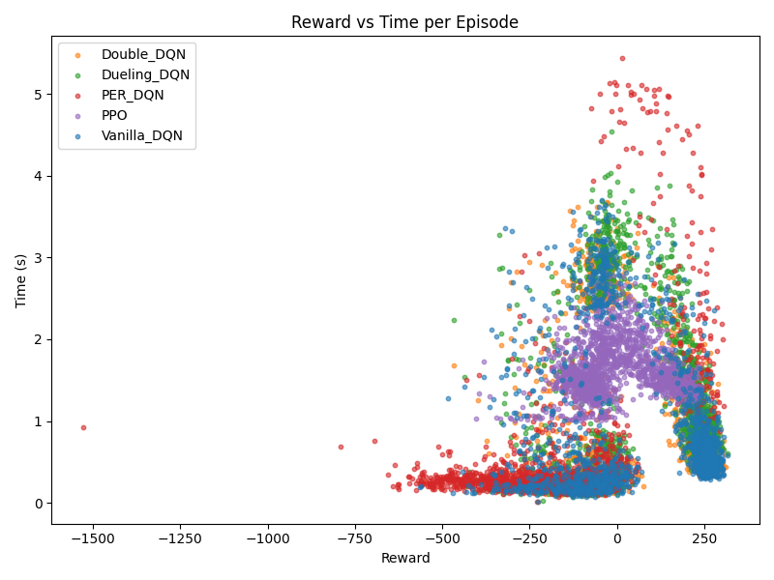
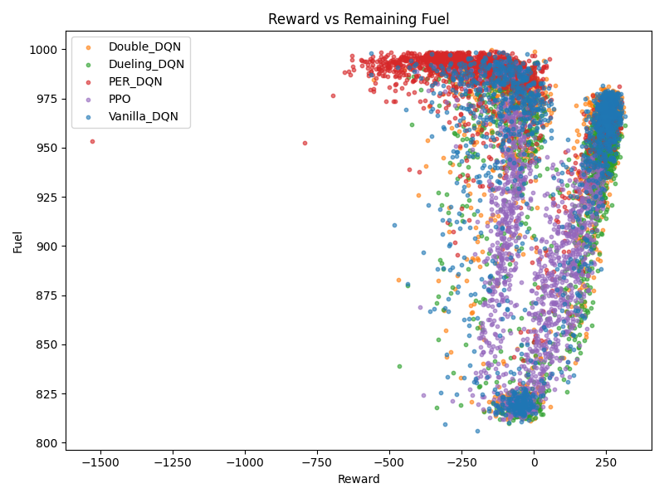
Learning Curves & Metrics
Overall Learning Curves
The mean-reward curve rises steeply for Double-/Dueling-DQN between episodes 150-300, then levels off.
PPO improves smoothly until ≈250 episodes, after which it fluctuates.
PER-DQN oscillates between –500 and –100 with no upward trend.
Reward ↔ Time Trade-off
Double-/Dueling episodes average ≈1.8 s at ~+250 reward – the best reward-per-second ratio.
PPO episodes cluster around 2 s but rewards vary widely.
PER-DQN shows extreme outliers (up to 5 s) that still yield negative reward
Reward ↔ Fuel Trade-off
Double-, Dueling-, and Vanilla-DQN form a dense “efficient” cluster at (+250 reward, ≈975 fuel).
PPO traces a V-shaped frontier: higher reward requires burning fuel down to ≈810.
PER-DQN hoards fuel (> 990) yet delivers poor rewards.

Slide 7
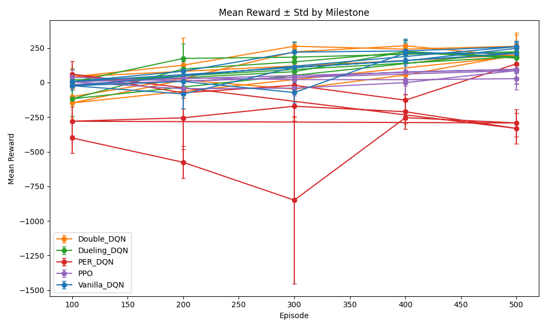
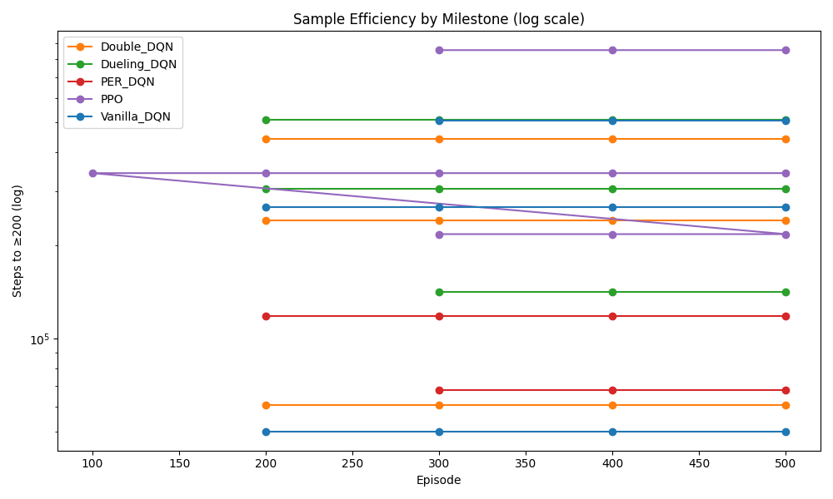
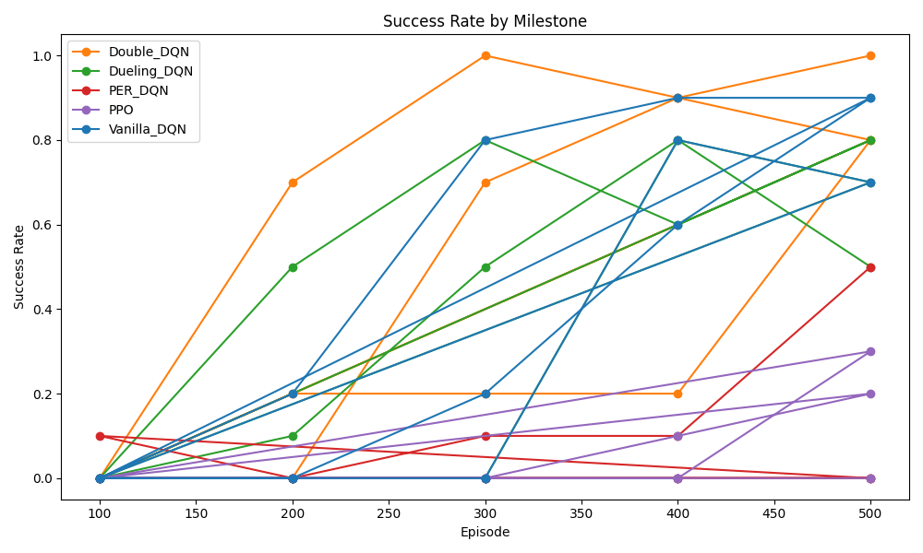
Learning Curves & Metrics
Milestone Success Rate
Double-DQN hits 100 % at episode 300 and stays ≥0.9.
Dueling- & Vanilla-DQN rise to 0.8–0.9 by episode 500.
PPO climbs slowly to 0.3; PER-DQN never exceeds 0.05.
Sample Efficiency
Double-DQN first crosses at ≈60 k env-steps.
Dueling-DQN at ≈70 k, Vanilla at ≈90 k.
PPO needs ≈140 k.
PER-DQN never reaches +200 within 500 episodes.
Reward Stability
Episode 100: all DQN variants negative; PPO hovering near 0.
Episode 300: Double- & Dueling-DQN cross +240 ± 40; Vanilla ~+120; PPO ~+70; PER-DQN ~–700.
Episode 500: Double- & Dueling-DQN settle at +260 ± 25; Vanilla +220 ± 40; PPO +120 ± 60; PER-DQN –300 ± 150.

Slide 8
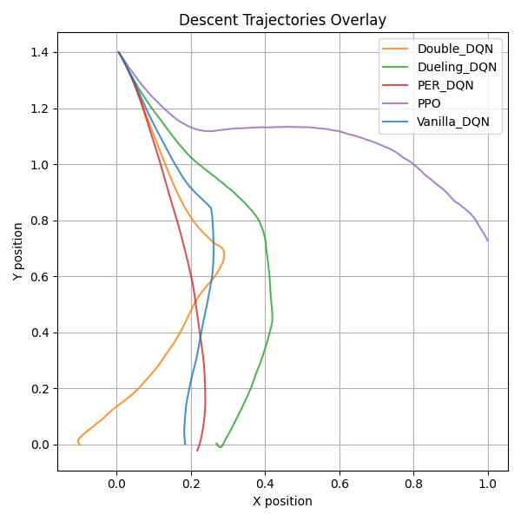
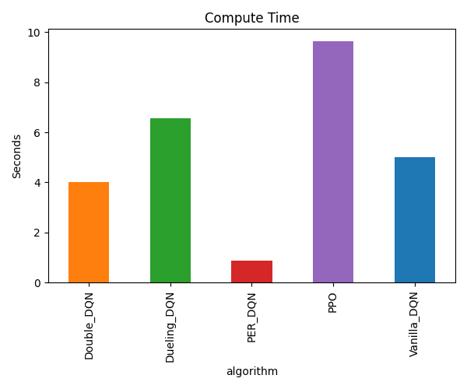
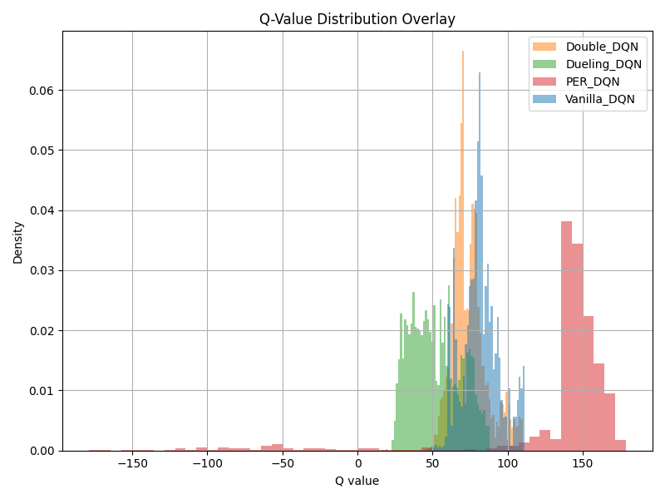
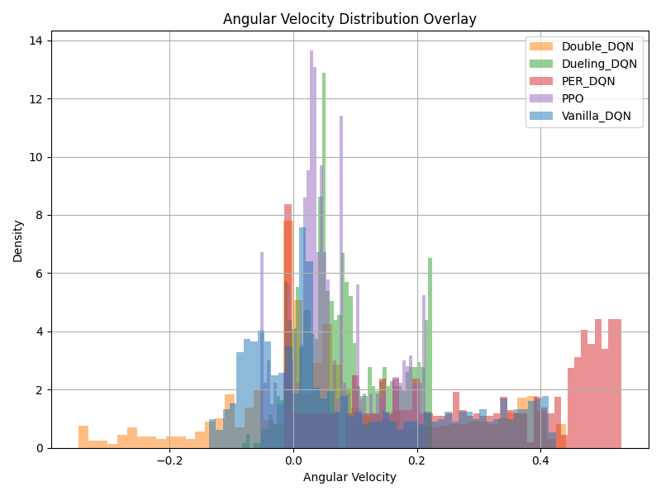
Learning Curves & Metrics
Angular-Velocity Histograms
PPO and the two winning DQNs exhibit narrow,
symmetric peaks centred near 0 rad s⁻¹;
PER-DQN has a heavy positive tail, indicating uncontrolled spin.
Compute Cost
PER-DQN trains fastest (< 1 s total);
Double- and Dueling-DQN require 4–6 s;
Vanilla ~5 s;
PPO slowest at ≈9.5 s for the 500-episode budget.
Q-Value Distributions
Double-DQN shows a tight bell around ~80;
Dueling-DQN around ~60;
Vanilla wider around ~90;
PER-DQN skewed right (~140) with a long negative tail, signalling over-confident estimates.
Descent trajectories
Value-based winners descend steeply in near-vertical paths, conserving fuel.
PPO follows a longer braking arc;
PER-DQN paths wobble and often overshoot.

Slide 9
Key Findings & Future Work
Leaderboard
Double-DQN now dominates on reward, success, fuel use, and runtime;
Dueling-DQN is a close second.
Vanilla DQN shows big late-game gains.
PPO remains robust but under-performs in reward and efficiency within the 500-episode cap.
PER-DQN collapses further, indicating that naïve TD-error prioritisation damages stability under sparse shaping.
Insights.
Proper reward shaping lets value-based methods excel on LunarLander, contradicting Atari-centric wisdom that favours policy gradients.
Steep descent profiles from DQNs suggest a different thrust strategy—cheap but effective.
Limitations.
500 episodes may still hide long-run behaviour.
Manual hyper-parameter tuning could bias results.
Only three seeds used.
Future Work.
Test Rainbow and SAC; dissect why PER fails.
Add energy-aware rewards and domain randomisation for robustness
Visualise decision boundaries; analyse rare-event handling

Slide 10
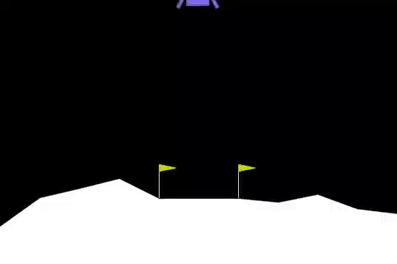
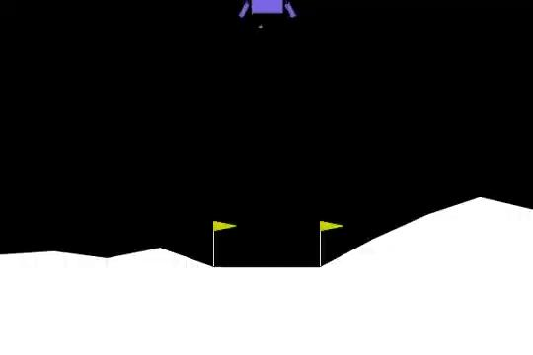
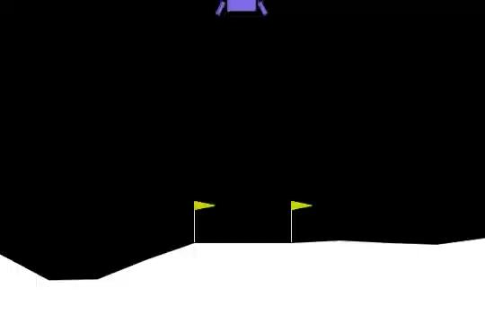
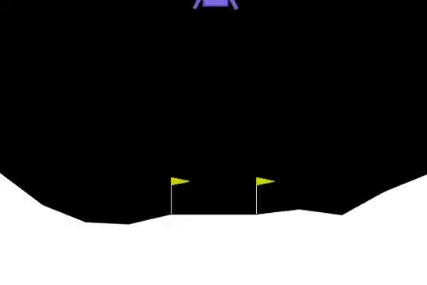
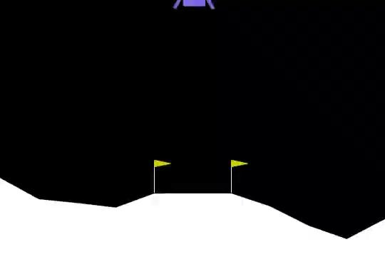
Agent Performance - Video Capture (after 500 episode training)
Double DQN
Duelling DQN
Vanilla DQN
PPO
PER DQN

Slide 11
Links & Acknowledgments
GitHub repo: Link
Thanks & questions are welcome!

